Slide 1
MCCP Channel & Cycle Plan Product

Slide 2
MCCP
Cycle Plans:
It provide the ability to guide users with a list of Targets (Accounts) within their Territory to properly promote company brands and messages over a specified period.
Cycle Plans are sometimes referred to as Plans of Action (POA).
Veeva CRM offers two different modules for Cycle Plans:
Cycle Plan Module:
It provides basic Cycle Plan functionality for activities from the Call2_vod object only.
Multi Channel Cycle Plan Module (MCCP):
It provides a different approach to Cycle Plans with the ability to plan and monitor activities from multiple channels. Those are:-
Call2_vod
EM_Event_vod
Medical_Event_vod
Multichannel_Activity_vod
Sent_Email_vod

Slide 3
MCCP
MCCP consists of two main components:
A Cycle: Stores the Cycle dates, channels, channel weights, channel criteria, products, product weights, etc...
A Cycle Plan: It contains the Territory and Target information.
Create an MCCP in the following order:
Creating a Cycle
Creating a Cycle Channel
Creating Cycle Products
Creating a Multichannel Cycle Plan
Creating a Multichannel Cycle Plan Target
Creating a Multichannel Cycle Plan Channel
Creating a Multichannel Cycle Plan Product

Slide 4
MCCP
Creating a Cycle:
From the MC Cycle Tab, create a new Cycle record. A Cycle must contain at least:
Name
Start Date
End Date
Status
Creating a Cycle Channel:
After creating a Cycle, Channels need to be added to the Cycle.
A Channel can be activities from one of the supported objects
Record Type
Channel Object
Channel Label
Channel Weight
Channel Criteria

Slide 5
MCCP
Creating Cycle Products:
After a Cycle Channel is created, products can optionally be added to the Cycle Channel.
If the Cycle Channel object = Call2_vod, products are queried from the Call2_Detail_vod object
If the Cycle Channel object = Sent_Email_vod, products are queried from the Sent_Email_vod object
If the Cycle Channel Object = Multichannel_Activity_vod, products are queried from the Multichannel_Activity_Line_vod object
Creating a Multichannel Cycle Plan:
Multichannel Cycle Plan records serve as the header record for the territory.
They are linked to a Cycle where the basic meta-data for the Cycle is stored.
The following fields are required:
Name
Territory
Owner (needs to be the MCCP End User)
Status
Cycle

Slide 6
MCCP
Creating a Multichannel Cycle Plan Target:
It is a child records of a Multichannel Cycle Plan, and they serve as the junction between a Cycle Plan and the targeted Accounts a Territory is supposed to take action against. The following fields are required:
Cycle Plan
Target
Status
Active = Target is active on the Plan
Merged = Target was the losing Account during an Account merge where both the winning and losing Account were both on the Plan. The winning Account's Target record remains untouched. A Target record where Status = Merged is ignored during calculations. These records can be deleted or remain on the Plan; they are considered ignored records.
Channel Interactions Goal

Slide 7
MCCP
Creating a Multichannel Cycle Plan Channel:
It is the connection between the Target and a Multichannel Cycle Channel. Only channels applicable to the Target are aligned to the Target. The following fields are required:
Record Type
Channel with Product - indicates the Cycle Plan Channel has products aligned to it and the Cycle Plan Products related list is on the respective Cycle Plan Channel page layout
Channel Only - indicates the Cycle Plan Channel is created and no products are aligned to it; the Products related list is not on the Cycle Plan Channel page layout
Cycle Plan Target
Cycle Channel - only Cycle Channels from the respective Cycle can be aligned

Slide 8
MCCP
Creating a Multichannel Cycle Plan Product:
Child records of a Cycle Plan Channel and they serve as the connection between the Targeted Account and the Products applicable for the Channel (not all Products under the Channel may be applicable to the Target). The following fields are required:
Cycle Plan Channel
Cycle Product - only Cycle Products from the respective Cycle Channel and Cycle can be aligned

Slide 9
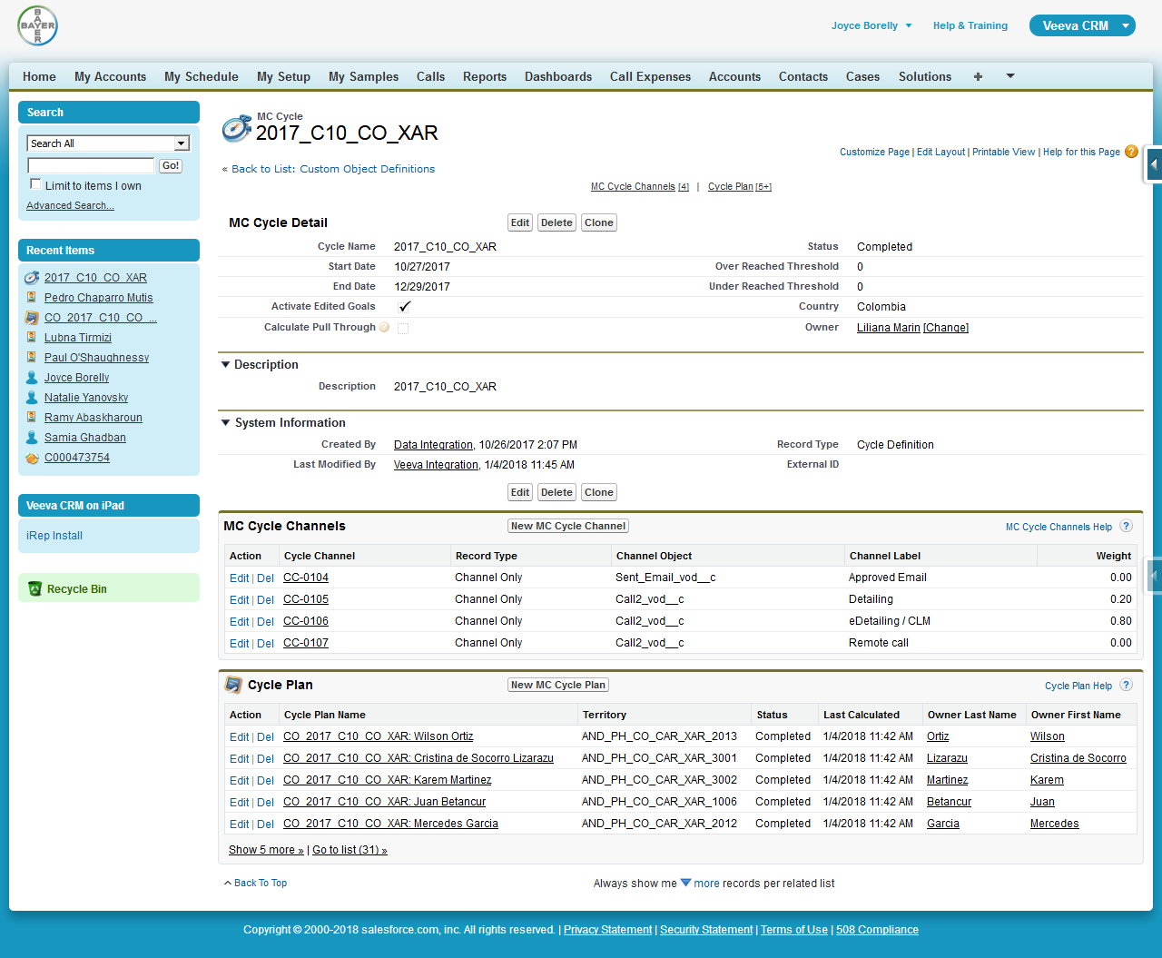
MC Cycle

Slide 10
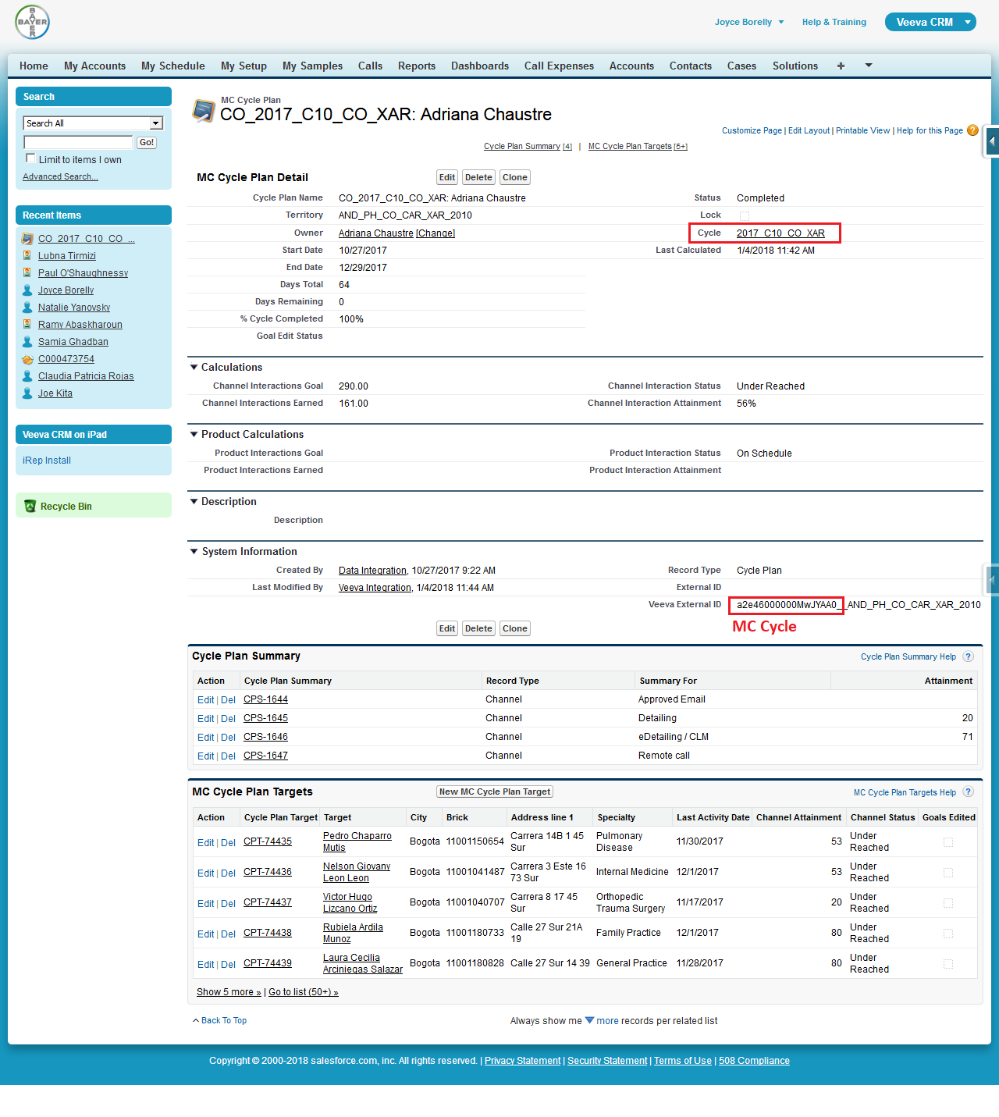
MC Cycle Plan

Slide 11
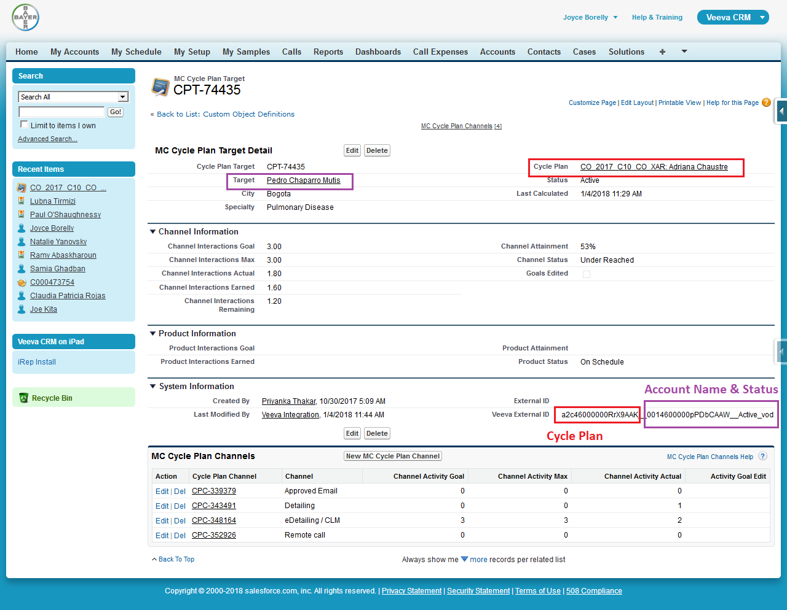
MC Cycle Plan Target

Slide 12
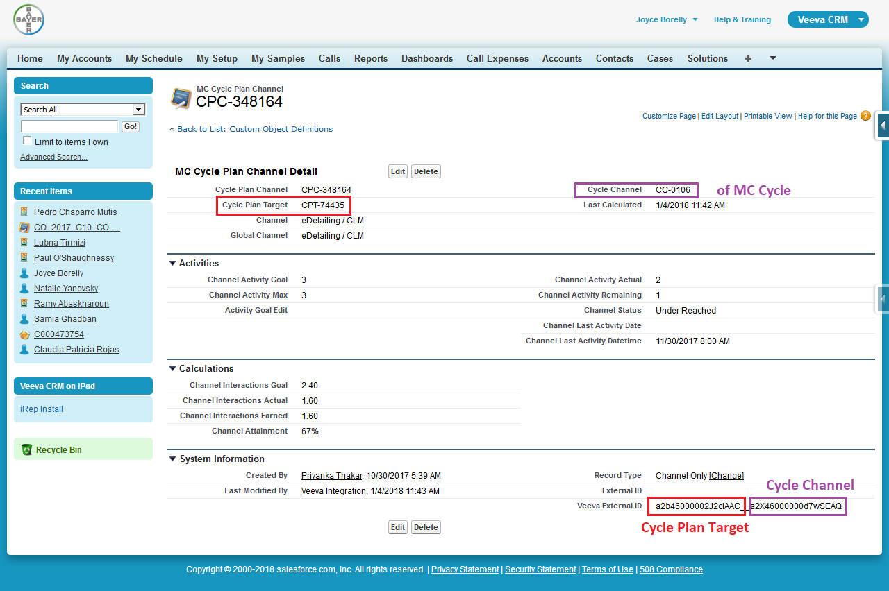
MC Cycle Plan Channel

Slide 13
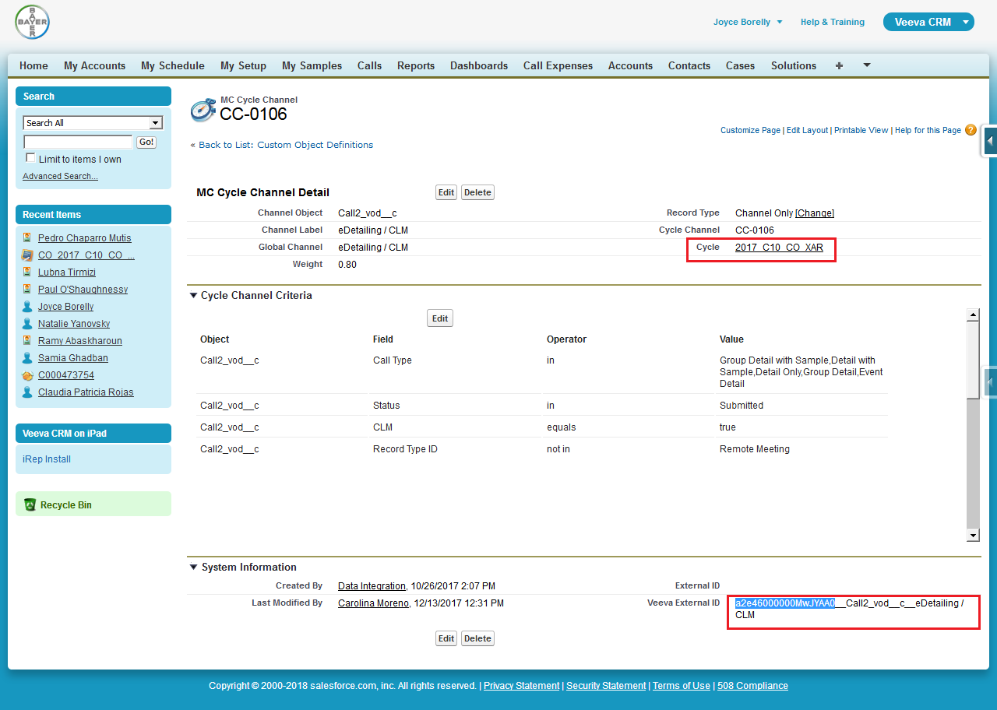
MC Cycle Channel of the MC Cycle

Slide 14
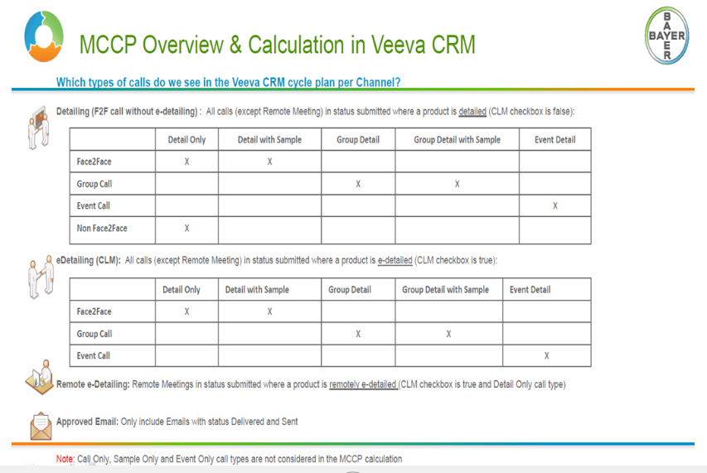

Slide 15
Thank you

